Slide 1
The Battle of Neighborhoods

Slide 2
Introduction
Background
Nowadays when an investor has to open a new restaurant in a big city has to choose the best location. Let’ talk about San Francisco which a very busy city, best known for tourist attractions and his business, therefore this city has restaurants a lot. Therefore, the correct location is important for an investor.

Slide 3
Problem
This project aims to recommend to an investor which are the best places to open a new restaurant based on data like crime rate and housing cost.

Slide 4
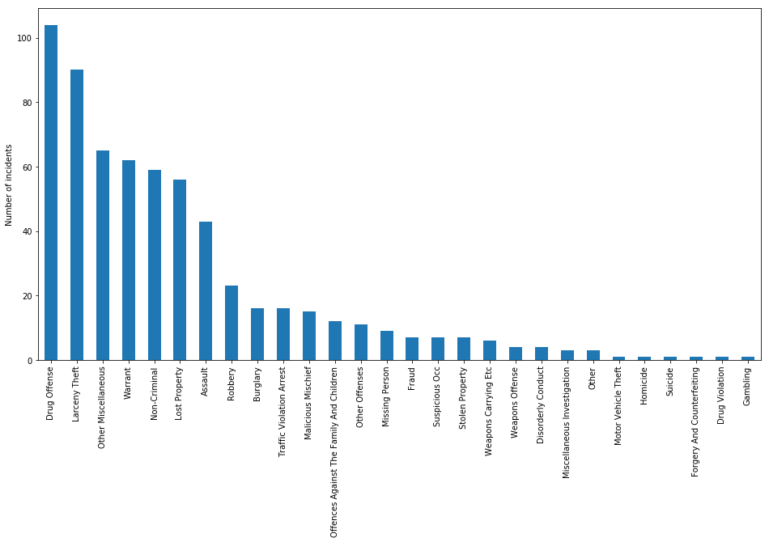
DATA
Crimes

Slide 5
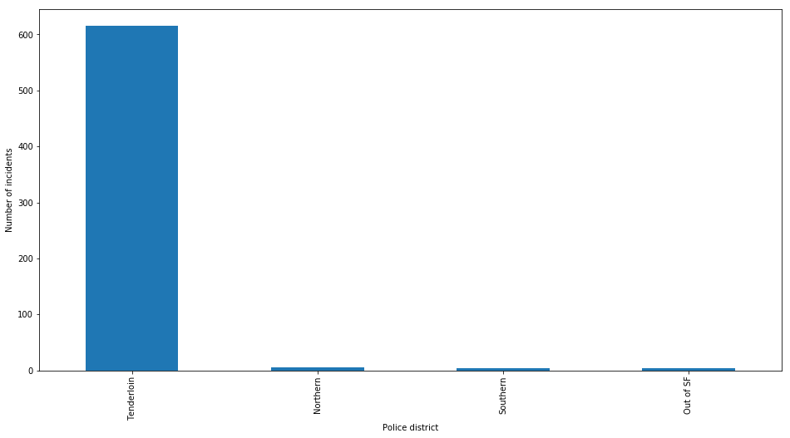

Slide 6
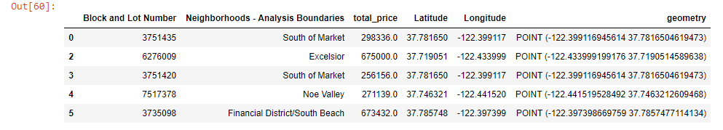
Housing

